Slide 1
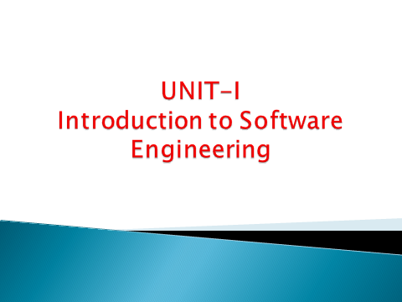

Slide 2
Topic Covered
Define s/w Engineering
Characteristics of s/w
Evolving Role of Software
Changing nature of software
Software Myths
Generic View of Process
1. Layered Technology.
2. Process Framework.
3. CMMI.

Slide 3
Definition Software Engineering
Software Engineering is the process of Designing, Developing, Testing, and Maintaining S/W Applications. It’s a branch of Computer Science that uses Engineering principles and Programming language to build s/w for end users.
OR
Software engineering is defined as analyzing user requirements and then designing, building, and testing software applications that will satisfy those requirements.

Slide 4
Characteristics of s/w
Characteristics of s/w
6 Types of s/w characeristics
1. Functionality
2. Usability (User-friendly)
3. Efficiency
4. Reliability
5. Maintainability
6. Portability

Slide 5
Functionality
1. suitability
2.accuracy
3. interoperability
4. compliance
5. security
2. Efficiency
1. In time
2. In Resource

Slide 6
Usability (User-friendly)
1. understandability
2. learnability
3.operability
Reliability
Recoverability
Fault tolerance
Maturity

Slide 7
Maintainability
1. Testability
2. Stability
3. Changability
4. operability
Portability
Adaptability
Installability
Replaceability

Slide 8
Evolving Role of Software
Software is a product
Software is a vehicle for delivering a product
Definition of Software
Hardware vs. Software
Manufacturing vs. Development
Failure curve for Hardware and Software
Component Based vs. Custom Built

Slide 9
Evolving Role of Software
1. Software is a product
Transforms information - produces, manages, modifies, displays, or transmits information
Delivers computing potential of hardware and networks
2. Software is a vehicle for delivering a product
Controls other programs (operating system)
Effects communications (networking software)
Helps build other software (software tools & environments)

Slide 10
3. What is Software?
Software can define as:
  Instruction – executed provide desire features, function & performance.
  Data structure – to adequately manipulate operation.
  Documents – operation and use of the program.
Software products may be developed for a particular customer or may be developed for a general market.

Slide 11
4. Hardware vs. Software
Hardware | Software
Manufactured wear out Built using components Relatively simple | Developed/ engineered deteriorate Custom built Complex

Slide 12
5. Manufacturing vs. Development
Once a hardware product has been manufactured, it is difficult or impossible to modify. In contrast, software products are routinely modified and upgraded.
In hardware, hiring more people allows you to accomplish more work, but the same does not necessarily hold true in software engineering.
Unlike hardware, software costs are concentrated in design rather than production.

Slide 13
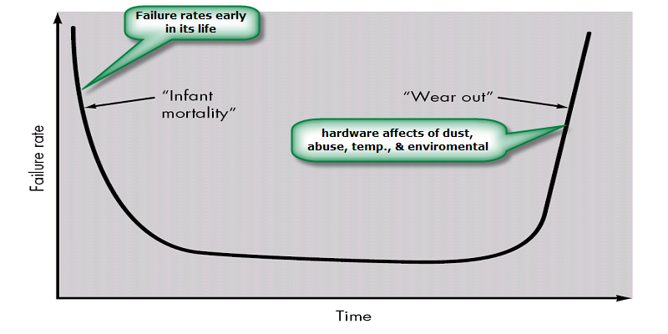
6.a. Failure curve for Hardware

Slide 14
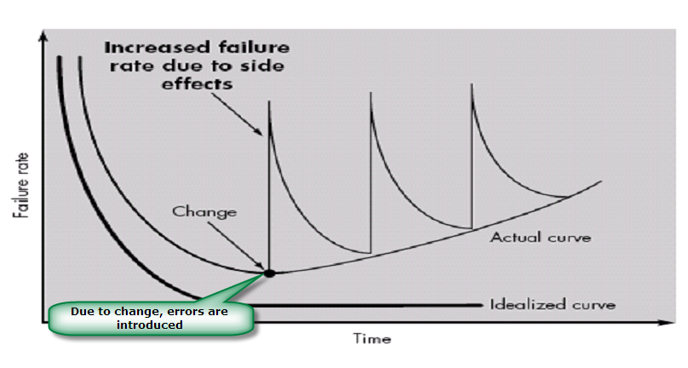
6.b. Failure curve for Software
When a hardware component wears out, it is replaced by a spare part.
There are no software spare parts. Every software failure indicates an error in design or in the process through which design was translated into machine executable code. Therefore, software maintenance involves considerably more complexity

Slide 15
7. Component Based vs. Custom Built
Hardware products typically employ many standardized design components.
Most software continues to be custom built.
The software industry does seem to be moving (slowly) toward component-based construction.

Slide 16
Changing nature of software
1. System software
2. Application software
3. Engineering/scientific software
4. Embedded software
5. Product line software
6. Web applications
7. Artificial intelligence software

Slide 17
1. System Software:
System software is a collection of programs written to service other programs.
It is characterized by heavy interaction with computer hardware; heavy usage by multiple users; concurrent operation that requires scheduling, resource sharing, complex data structures; and multiple external interfaces.
Ex. Compilers, operating system, drivers etc.
2. Application Software :
Application software consists of standalone programs that solve a specific business need.
Application software is used to control the business function in real time.
Ex: Microsoft Office, VLC media player, Jet audio, Google chrome
3. Engineering /Scientific software:
Characterized by "number crunching" algorithms.
Scientific and engineering software satisfies the needs of a scientific or engineering user to perform enterprise-specific tasks. Such software is written for specific applications using principles, techniques, and formulae particular to that field.
Ex. Computer-Aided Design (CAD), MATLAB, AUTOCAD

Slide 18
4. Embedded Software:
Controlling devices and machines that are different from traditional computers using software engineering.
Designing, developing, and testing software embedded within hardware devices or systems.
Ex. keypad control for a microwave oven, Traffic control systems.
5. Product line software:
Designed to provide a specific capability for use by many different customers, product line software can focus on a limited marketplace.
Ex. Word processing, spreadsheet, CG, multimedia, etc.
6. Web Applications:
Web apps can be little more than a set of linked hypertext files.
It is evolving into sophisticated computing environments that provide standalone features and functions and are integrated with corporate database and business applications.
Ex: online forms, shopping carts, word processors, spreadsheets, video and photo editing.
7. Artificial Intelligence software
AI software makes use of non-numerical algorithms to solve complex problems and straightforward analysis
Ex. Robotics, expert systems, game playing, Manufacturing robots, Smart assistants, healthcare management, Disease mapping, Automated financial investing, Virtual travel booking agent, Social media monitoring

Slide 19
Software Myths
Definition: Beliefs about software and the process used to build it. Myths have number of attributes that have made them insidious (i.e. dangerous).
Misleading Attitudes - caused serious problem for managers and technical people.
There are three types of S/W Myths
1. Management myths
2. Customer myths
3. Practitioner’s/Developer’s myths
1. Management myths
Managers in most disciplines, are often under pressure to maintain budgets, keep schedules on time, and improve quality.
Myth1: If we get behind schedule, we can add more programmers and catch up
Reality: Software development is not a mechanistic process like manufacturing. Adding people to a late software project makes it later.
People can be added but only in a planned and well-coordinated manner

Slide 20
Myth2: If I decide to outsource the software project to a third party, I can just relax and let that firm build it.
Reality: If an organization does not understand how to manage and control software projects internally, it will invariably struggle when it outsource software projects
The more features we add, the better the product."
Reality: Focusing on user needs and core functionalities often leads to a more valuable product than simply adding features.
2. Customer Myths
Customer may be a person from inside or outside the company that has requested software under contract.
Myth: Once the software is developed, it’s done."
Reality: Software requires ongoing maintenance, updates, and support, even after deployment.
Myth: Project requirements continually change, but change can be easily accommodated because software is flexible.
Reality: Customer can review requirements and recommend modifications with relatively little impact on cost. When changes are requested during software design, the cost impact grows rapidly.

Slide 21
3. Practitioner’s/Developer myths
1. More code means better software."
Reality: Quality, maintainability, and simplicity are often more important than quantity. Less code can lead to fewer bugs and easier maintenance.
2. "All bugs can be fixed."
Reality: While many bugs can be resolved, it’s impossible to eliminate all of them. The goal is to reduce risk to an acceptable level.
3. "Testing is just a phase."
Reality: Testing should be integrated throughout the development process, not just a final step before release.
4. Documentation is a waste of time."
Reality: Proper documentation is essential for onboarding, collaboration, and future maintenance. It saves time in the long run.

Slide 22
A Generic view of Software Process

Slide 23
Chapter - Topic Covered
A Layered Technology
A Process Framework
  Generic Process Framework Activities
  Umbrella Activities
CMMI Level

Slide 24
Overview
What? A software process –A series of activities that are required to build high-quality software.
Who? Managers, software engineers, and customers.
Steps? A handful of activities are common to all software processes, and details.
Work product? Programs, documents, and data.
A generic view means general/common/not specific / Non-specialized/Universal / General-purpose.

Slide 25
Software Engineering – Layered Technology
Software engineering is a fully layered technology, to develop software we need to go from one layer to another. All the layers are connected and each layer demands the fulfillment of the previous layer.
Layered Technology
Tools: CASE preferred
Methods: technical “how to’s”
Process model: the “framework”
A quality focus: the “bedrock”

Slide 26
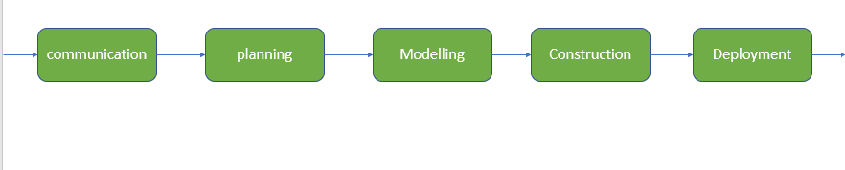
Layered technology is divided into four parts:
1. A quality focus: It defines the continuous process improvement principles of software.
It provides integrity which means providing security to the software so that data can be accessed by only an authorized person,no outsider can access the data. It also focuses on maintainability and usability.
2. Process: It is the foundation or base layer of software engineering.
It is key that binds all the layers together which enables the development of software before the
deadline or on time.
Process defines a framework that must be established for the effective delivery of software engineering
technology.
The software process covers all the activities, actions, and tasks required to be carried out for
software development.
.

Slide 27
Layered Technology
Process activities are listed below:-
Communication: It is the first and foremost thing for software development.
Communication is necessary to know the actual demand of the client.
Planning: It means drawing a map to reduce the complications of development.
Modeling: In this process, a model is created according to the client for better understanding.
Construction: It includes the coding and testing of the problem.
Deployment:- It includes the delivery of software to the client for evaluation and feedback
3. Methods:
Methods encompass a broad array of tasks that include requirements analysis, design, program construction, testing, and support.
There could be more than one technique to perform a task and different techniques could be used in different situations.
4. Tools:
Provide automated or semi-automated support for the process, methods and quality control.
When tools are integrated so that another can use information created by one tool, a system for the support of software development, called computer-aided software engineering (CASE)

Slide 28
Process framework
Provides the foundation for a complete software process.
Identified a small number of framework activities that are applicable to all software projects, regardless of their size or complexity.
It encompasses a set of umbrella activities that are applicable across the entire software process.

Slide 29
Process Framework
Each framework activities is populated by a set for software engineering actions – a collection of related tasks.
Each action has individual work task.

Slide 30
Generic Process Framework Activities
Communication:
  Heavy communication with customers, stakeholders, team
  Encompasses requirements gathering and related activities
Planning:
  Workflow that is to follow
  Describe technical task, likely risk, resources will require, work products to be produced and a work schedule.
Modeling:
  Help developer and customer to understand requirements (Analysis of requirements) & Design of software
Construction
  Code generation: either manual or automated or both
  Testing – to uncover error in the code.
Deployment:
  Delivery to the customer for evaluation
  Customer provide feedback

Slide 31
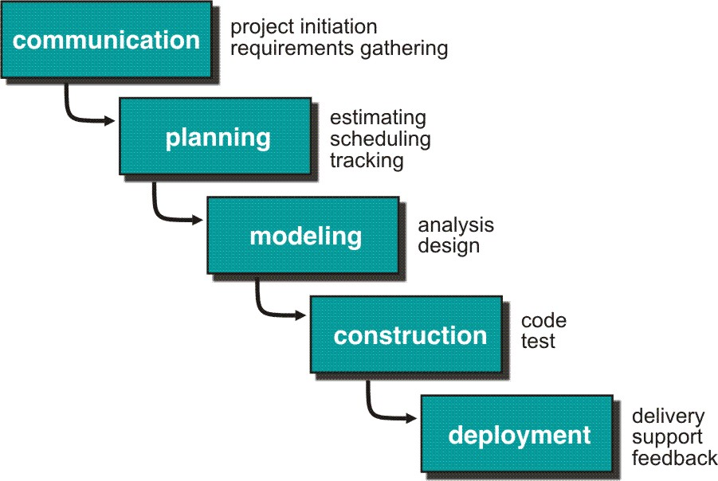

Slide 32
Umbrella Activities
Umbrella activities are a series of steps or procedures followed by a software development team to maintain the progress, quality, changes, and risks of complete development tasks.
Software project tracking and control
  Assessing progress against the project plan.
  Take adequate action to maintain schedule.
Formal technical reviews
  Assessing software work products in an effort to uncover and remove errors before goes into next action or activity.
Software quality assurance
  Define and conducts the activities required to ensure software quality.
Software configuration management
  Manages the effects of change.

Slide 33
Document preparation and production
  Help to create work products such as models, documents, logs, form and list.
Reusability management
  Define criteria for work product reuse
  Mechanisms to achieve reusable components.
Measurement
  Define and collects process, project, and product measures
  Assist the team in delivering software that meets customer’s needs.
Risk management
  Assesses risks that may effect that outcome of project or quality of product (i.e. software)

Slide 34
Capability Maturity Model Integration (CMMI)
The Software Engineering Institute (SEI) has developed a process meta-model to measure an organization’s process capability and maturity levels.
CMMI – developed by SEI
The CMMI defines each process area in terms of “specific goals” and the “specific practices” required to achieve these goals.
Specific goals establish the characteristics that must exist if the activities implied by a process area are to be effective.
Specific practices refine a goal into a set of process-related activities.
A representation allows an organization to pursue a different set of Improvement objectives. There are two representations for CMMI :
Staged Representation(maturity Levels)
Continuous Representation(Capability Levels)

Slide 35
CMMI Level
CMMI Model – Maturity Levels
In CMMI with staged representation, there are five maturity levels described as follows :
Maturity level 1: Initial
  processes are poorly managed or controlled.
  unpredictable outcomes of processes involved.
  No KPAs (Key Process Areas) defined.
  Lowest quality and highest risk.
Maturity level 2: Managed
  1. requirements are managed.
  processes are planned and controlled.
  projects are managed and implemented according to their documented plans.
  This risk involved is lower than Initial level, but still exists.
  Quality is better than Initial level.

Slide 36
Maturity level 3 : Defined
  1. processes are well characterized and described using standards, proper procedures, and methods, tools, etc.
  2. Medium quality and medium risk involved.
  Focus is process standardization.
Maturity level 4 : Quantitatively managed
  1. quantitative objectives for process performance and quality are set.
  2. quantitative objectives are based on customer requirements, organization needs, etc.
  3. process performance measures are analyzed quantitatively.
  Higher quality of processes is achieved.
  lower risk
Maturity level 5 : Optimizing
  1. continuous improvement in processes and their performance.
  2. improvement has to be both incremental and innovative.
  3. highest quality of processes.
  4. lowest risk in processes and their performance.

Slide 37
CMMI models with continuous representation, there are six capability levels as described below
Capability level 0 : Incomplete
  incomplete process – partially or not performed.
  one or more specific goals of process area are not met.
  No generic goals are specified for this level.
  this capability level is same as maturity level 1.
Capability level 1 : Performed
  process performance may not be stable.
  objectives of quality, cost and schedule may not be met.
  a capability level 1 process is expected to perform all specific and generic practices for this level.
  only a start-step for process improvement.
Capability level 2 : Managed
  process is planned, monitored and controlled.
  managing the process by ensuring that objectives are achieved.
  objectives are both model and other including cost, quality, schedule.
  actively managing processing with the help of metrics.

Slide 38
Capability level 3: Defined
  1. a defined process is managed and meets the organization’s set of guidelines and standards.
  2. The focus is process standardization.
Capability level 4: Quantitatively Managed
  1. The process is controlled using statistical and quantitative techniques.
  2. Process performance and quality is understood in statistical terms and metrics.
  3. quantitative objectives for process quality and performance are established.
Capability level 5: Optimizing
  1. focuses on continually improving process performance.
  2. Performance is improved in both incremental and innovative ways emphasizing on studying the performance results across the organization to ensure that common causes or issues are identified and fixed.

